Slide 1
Digital Portfolio
STUDENT NAME: Narendhiran G
REGISTER NO AND NMID: 32324U18028 & astvu32332324u18028
DEPARTMENT: B.Sc Computer Science
COLLEGE: Voorhees College

Slide 2
PROJECT TITLE
Student portfolio by using frontend developement

Slide 3


AGENDA
Problem Statement
Project Overview
End Users
Tools and Technologies
Portfolio design and Layout
Features and Functionality
Results and Screenshots
Conclusion
Github Link
3/21/2024 Annual Review

Slide 4

PROBLEM STATEMENT
In today’s competitive digital era, having an online presence is essential for professionals and developers to showcase their skills and projects. The problem is that many individuals rely solely on resumes, which do not effectively display creativity, design skills, or interactive elements.The goal is to create a personal portfolio website that presents the user’s profile, skills, projects, and contact information in a visually appealing, interactive, and user-friendly way.

Slide 5

PROJECT OVERVIEW
This project is a personal portfolio website designed using HTML, CSS, and JavaScript
It has multiple sections including
Home Section with an introduction
About Section with a circular profileImage
Section listing sample projectsContact Section with a functional formThe website uses smooth scrolling navigation and interactive design elements (hover effects, buttons, etc.) to improve user experience.

Slide 6

WHO ARE THE END USERS?
Students & Developers – who want to showcase their work to recruiters.Recruiters & Hiring Managers – who can view the developer’s skills and projects in one place.Clients – who might want to hire the developer for freelance projects.

Slide 7

TOOLS AND TECHNIQUES
HTML5 – for structure and layout
CSS3 – for styling, colors, fonts, and responsiveness
Google Fonts (Pacifico) – for beautiful typography
JavaScript-for smooth scrolling and form handling
Browser Developer Tools – for testing and debugging

Slide 8
POTFOLIO DESIGN AND LAYOUT
Header with Navigation Bar (Home, About, Projects, Contact)
Hero Section – with introduction text and a call-to-action buttonAbout Section – with a circular profile image and descriptionProjects Section – with neatly designed project cardsContact Section – with a simple form and alert on submissionFooter – with copyright informationThe design uses a soft color gradient background, rounded edges, and drop shadows to create an elegant look
8

Slide 9
FEATURES AND FUNCTIONALITY
✅ Smooth Scroll: Clicking a button scrolls to the target section smoothly.
✅ Responsive Design: Works on desktop, tablet, and mobile.
✅ Circular Profile Image: Styled with CSS for a modern look.
✅ Interactive Project Cards: Hover effects for better engagement.
✅ Functional Contact Form: Prevents page reload and shows a thank-you alert.
Sticky Navigation Bar: Always visible while scrolling.

Slide 10

RESULTS AND SCREENSHOTS
Successfully built a responsive, visually appealing portfolio website. Smooth navigation and user-friendly interface enhance the experience. 📸 Screenshots: Home Section: Show introduction and call-to-action button About Section: Show circular image with text beside it Projects Section: Show project cards Contact Section: Show contact form
3/21/2024 Annual Review
10

Slide 11
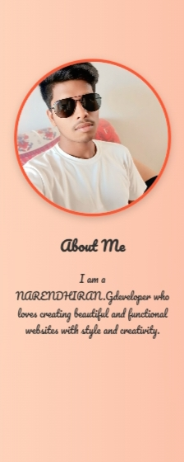
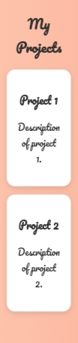
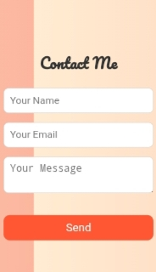

Slide 12
CONCLUSION
This project demonstrates the ability to create a professional, well-structured, and interactive portfolio website using HTML, CSS, and JavaScript.It provides an effective way for a developer to present their skills and work online, helping with career opportunities and networking.
12

